Slide 1

Python Confidence Course
By Bey Hao Yun

Slide 2
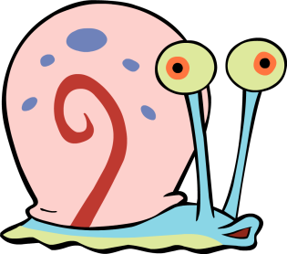

A Bit About Myself
Bey Hao Yun (Gary)
Currently a third-year Computer Engineering student at NUS
Have coded my own python-based website before. Refer to the following link: https://github.com/StylishGoldPen/projection_latest
Led a development team in university to produce our own task-management application. Refer to the following link: https://github.com/CS2103AUG2016-T09-C3/main
Had no prior experience in coding before university.

Slide 3
Course Overview
What is programming? Why learn Python?
What is Python?
Basics
Object-Oriented Programming (Philosophy)
Object-Oriented Programming (Designer mode)
Conclusion

Slide 4
What is Programming?
“ Programming is the process of taking an algorithm and encoding it into a notation, a programming language, so that it can be executed by a computer.”
From http://interactivepython.org/courselib/static/pythonds/Introduction/WhatIsProgramming.html
Programming is essentially learning a new language which only computers can speak.

Slide 5

But why speak to the computer?
Take for instance, you are asking a worker to do something for you, say, call someone else.
The worker would be doing it at human speed.
Find phone
Pick up phone
Dial in number
Speak to the other person
Hang up phone

Slide 6
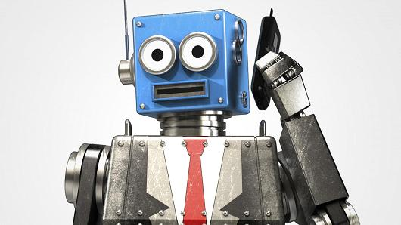
But why speak to the computer?
Now, replace the worker with an automated call system; A computer.
It will be doing those exact same steps at computer speed which is vastly more superior than human speed.

Slide 7
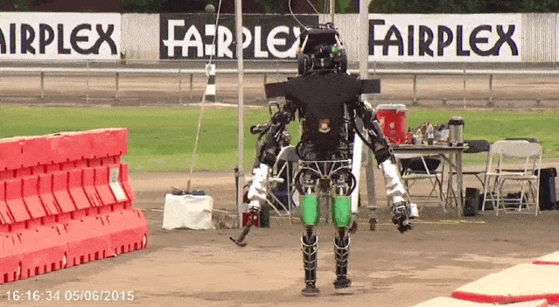
Speaking it right
However, keep in mind that the main drawback is that the computer, while it is extremely fast in its operations, is ridiculously dumb.

Slide 8
Therefore, coding it right is vitally important in programming.
Much like having clear communication in English or Mother Tongue.

Slide 9

Why Learn Python?
Python is a beginner-friendly and far more human-readable language.
Python is open-source.
It is used successfully in thousands of real-world business applications around the world, including many large and mission critical systems.

Slide 10






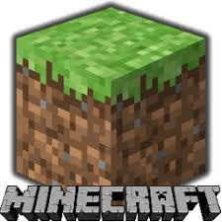

Who Uses Python?

Slide 11

And of course...

Slide 12
Therefore, it is a language which is easy-to-learn and widely-used.

Slide 13
What is Python?
“Python is an interpreted, object-oriented, high-level programming language with dynamic semantics.”
From https://www.python.org/doc/essays/blurb/
Latest version of Python is 3.6.1.
From my experience, mainly used in Web Development and Data-analytics.

Slide 14
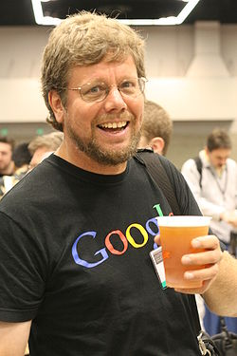

Brief History of Python
Created by Guido Van Rossum.
Started in 1989 in the Netherlands.
It is called Python because he took inspiration from the British comedy group “Monty Python”.

Slide 15
Basics

Slide 16
Setting up
Start your python program with this statement. ”#!/usr/bin/env python”
“Import” your necessary packages.
Write the rest of your program according to the function you want.

Slide 17
Run Cycle of a Python Program
python <filename>.py
Unlike the more common Java and C programs, Python does not need a separate compiler. It does its own compiling at runtime.
Python programs are easily identified by its file extension “.py”.

Slide 18
Run Cycle of Other Programs
 | C | Java
Text Editor (e.g. VIM, Eclipse, Sublime Text Editor) | vim welcome.c | vim Welcome.java
Compiler (C compiler vs. Java compiler) | gcc –Wall welcome.c | javac Welcome.java
Execution (Executable file vs. Java Virtual Machine) | a.out | java Welcome

Slide 19
Python Identifiers
A Python identifier is a name used to identify a variable, function, class, module or other object. An identifier starts with a letter A to Z or a to z or an underscore (_) followed by zero or more letters, underscores and digits (0 to 9).

Slide 20
Practices
Variable
foo1
9catslife
_spinner
_$fidget
%_variable
!pcc
_!pcc

Slide 21
Naming Conventions
Here are the naming conventions for Python identifiers −
Class names start with an uppercase letter. All other identifiers start with a lowercase letter.
Starting an identifier with a single leading underscore indicates that the identifier is private.
Starting an identifier with two leading underscores indicates a strongly private identifier.
If the identifier also ends with two trailing underscores, the identifier is a language-defined special name.
Notes:
Add naming convertion exercise after this.

Slide 22


Lines and Indentation
Python provides no braces to indicate blocks of code for class and function definitions or flow control. Blocks of code are denoted by line indentation, which is rigidly enforced.
if True:
print “True”
else:
print “False”
if True:
print “True”
else:
print “False”

Slide 23
Data Types
Python has five standard data types
Numbers (*)
String (*)
List (*)
Tuple
Dictionary

Slide 24
Numbers
Number data types store numeric values. Number objects are created when you assign a value to them.
Var1 = 1
Var2 = 10
Python supports four different numerical types
int (signed integers)
long (long integers, they can also be represented in octal and hexadecimal)
float (floating point real values)
complex (complex numbers)

Slide 25
Numbers
int | long | float | complex
10 | 51924361L | 0.0 | 3.14j
100 | -0x19323L | 15.20 | 45.j
-786 | 0122L | -21.9 | 9.322e-36j
080 | 0xDEFABCECBDAECBFBAEl | 32.3+e18 | .876j
-0490 | 535633629843L | -90. | -.6545+0J
-0x260 | -052318172735L | -32.54e100 | 3e+26J
0x69 | -4721885298529L | 70.2-E12 | 4.53e-7j

Slide 26
Strings
Strings in Python are identified as a contiguous set of characters represented in the quotation marks.
Python allows for either pairs of single or double quotes. Subsets of strings can be taken using the slice operator ([ ] and [:] ) with indexes starting at 0 in the beginning of the string.
str = ‘Hello World’
0 | 1 | 2 | 3 | 4 | 5 | 6 | 7 | 8 | 9 | 10
str = “Hello World”
H | E | L | L | O |  | W | O | R | L | D
Notes:
Add exercises to this

Slide 27
Lists
Lists are the most versatile of Python's compound data types. A list contains items separated by commas and enclosed within square brackets ([]).
list = [‘hugh’, 786, 2.23, ‘jackman’, ‘s’ , ‘ger’ ]
0 | 1 | 2 | 3 | 4 | 5
Hugh | 786 | 2.23 | Jackman | s | ger
Notes:
Add exercise after this

Slide 28
Basic Operators
Operators are the constructs which can manipulate the value of operands.
Python language supports the following types of operators.
Arithmetic Operators (*)
Comparison (Relational) Operators (*)
Assignment Operators (*)
Logical Operators Bitwise Operators
Membership Operators
Identity Operators
Notes:
Add exercise after this

Slide 29
Arithmetic Operators
Assume variable a holds 10 and variable b holds 20, then
Operator | Description | Example
+ Addition | Adds values on either side of the operator. | a + b = 30
- Subtraction | Subtracts right hand operand from left hand operand. | a – b = -10
* Multiplication | Multiplies values on either side of the operator | a * b = 200
/ Division | Divides left hand operand by right hand operand | b / a = 2
% Modulus | Divides left hand operand by right hand operand and returns remainder | b % a = 0
** Exponent | Performs exponential (power) calculation on operators | a**b =10 to the power 20
// | Floor Division - The division of operands where the result is the quotient in which the digits after the decimal point are removed. But if one of the operands is negative, the result is floored, i.e., rounded away from zero (towards negative infinity): | 9//2 = 4
Notes:
Add exercise after this

Slide 30
Comparison Operators
These operators compare the values on either sides of them and decide the relation among them.
== | If the values of two operands are equal, then the condition becomes true. | (a == b) is not true.
!= | If values of two operands are not equal, then condition becomes true.
> | If the value of left operand is greater than the value of right operand, then condition becomes true. | (a > b) is not true.
< | If the value of left operand is less than the value of right operand, then condition becomes true. | (a < b) is true.
>= | If the value of left operand is greater than or equal to the value of right operand, then condition becomes true. | (a >= b) is not true.
<= | If the value of left operand is less than or equal to the value of right operand, then condition becomes true. | (a <= b) is true.
Notes:
Add exercise after this

Slide 31
Assignment Operators
Assume variable a holds 10 and variable b holds 20, then
= | Assigns values from right side operands to left side operand | c = a + b assigns value of a + b into c
+= Add AND | It adds right operand to the left operand and assign the result to left operand | c += a is equivalent to c = c + a
-= Subtract AND | It subtracts right operand from the left operand and assign the result to left operand | c -= a is equivalent to c = c - a
*= Multiply AND | It multiplies right operand with the left operand and assign the result to left operand | c *= a is equivalent to c = c * a
/= Divide AND | It divides left operand with the right operand and assign the result to left operand | c /= a is equivalent to c = c / ac /= a is equivalent to c = c / a
%= Modulus AND | It takes modulus using two operands and assign the result to left operand | c %= a is equivalent to c = c % a
**= Exponent AND | Performs exponential (power) calculation on operators and assign value to the left operand | c **= a is equivalent to c = c ** a
//= Floor Division | It performs floor division on operators and assign value to the left operand | c //= a is equivalent to c = c // a
Notes:
Add exercise after this

Slide 32

Let’s start coding!

Slide 33
Basic Functionalities
“Hello World” - Outputting
Inputting
Mathematical Calculation
Strings
Lists
Conditional Statements
Looping

Slide 34
Hello World (Outputting)
Your very first program
#!/usr/bin/env python
print (‘Hello World!’)

Slide 35
Inputting
Your second program
#!/usr/bin/env python
foo = raw_input(“Enter your input: ”)
print (“You entered: ” + foo)
#!/usr/bin/env python
foo = input("Enter your integer input: ")
print ("Your integer input is: “ + foo)
Receiving input as an integer
#!/usr/bin/env python
foo = input("Enter your input: ")
print "Your integer input is: “, foo
Notes:
Add after this a slide about always refering to the documentation.

Slide 36
Mathematical Calculations
Calculate the area of a rectangle by taking in inputs for the width and length respectively and printing out the product of the two numbers
#!/usr/bin/env python
import math
width = input("Enter width: ")
length = input("Enter length: ")
area = width * length
print "Total area of rectangle is : " , area , "cm2."

Slide 37

Exercise 1
Create a program which calculates and outputs the volume of a cuboid by taking in 3 integer inputs (height, width, length ).
Create a program that calculates and outputs the area of a circle by taking in 1 integer input
Hint: $A=πr^{2}$
Hint:
Create a program that calculates and outputs the volume of a sphere by taking in 1 integer input
Hint: $V= \frac{4}{3}$ $πr^{3}$
area = math.pi * math.pow(r,2)

Slide 38
Strings
Python strings contain many interesting features which you can use to manipulate the content of the string to what you want.
#!/usr/bin/env python
_daword = input(“Input the word: ”)
index = int(input(“Input the index: ”))
print(“The letter you want is: ” + _daword[index] + “.”)
Notes:
Add in can anyone tell me what happens when you refer to an index outside the boundaries? Don’t wait for me to tell find out for yourself.

Slide 39
Exercise 2
Create a program which takes in a string input, capitalizes only the first letter and prints out the resulting string.
hint: keyword: capitalize
hint: Refer to the docs.
Create a program which takes in a string input and outputs false if it contains a digit
Hint: isalpha()
Create a program which takes in a string and outputs its length.
Hint: len(variablename)
Create a program which counts the number of occurrences of the same character in a string and returns the counting.

Slide 40
Lists
The structure of lists works similiarly to that of Strings. The following code allows to update a list.
#!/usr/bin/env python
list = ['physics', 'chemistry', 1997, 2000]
print "Value available at index 2 : "
print list[2]
list[2] = 2001
print "New value available at index 2 : "
print list[2]
Notes:
Add in can anyone tell me what happens when you refer to an index outside the boundaries? Don’t wait for me to tell find out for yourself.

Slide 41
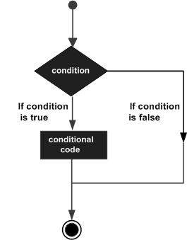
Conditional Statements
The structure of lists works similarly to that of Strings. The following code allows to update a list. keywords: if-elif-else
#!/usr/bin/env python
var = 100
foo = int(input())
if (foo > var ):
print(“The number you input is more than 100.”)
else:
print(“The number you input is less than 100.”)
Notes:
Can anyone tell me what is the flaw in this program.

Slide 42
Exercise 3
Fix the flaw in the previous program.
hint: keyword: elif
Improve upon the earlier program written to do with strings. Print out the error message “Index out of bounds” if the index integer input is more than the length of the string input.
#!/usr/bin/env python
_daword = input(“Input the word: ”)
index = int(input(“Input the index: ”))
print(“The letter you want is: ” + _daword[index] + “.”)

Slide 43
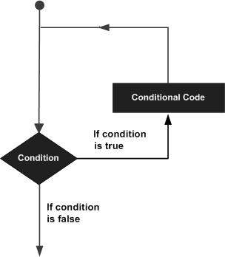
Looping
In general, statements are executed sequentially: The first statement in a function is executed first, followed by the second, and so on. There may be a situation when you need to execute a block of code several number of times.
There are different ways to loop your program.
Notes:
Can anyone tell me what is the flaw in this program.

Slide 44
Looping
while loop
for loop
#!/usr/bin/env python count = 0 while (count < 9):
print *'The count is:', count)
count = count + 1
print ("Good bye!“)
#!/usr/bin/env python
for letter in 'Python':
print ('Current Letter :', letter)
fruits = ['banana', 'apple', 'mango']
for fruit in fruits:
print ('Current fruit :', fruit)
print ("Good bye!“)
Notes:
Can anyone tell me what is the flaw in this program.

Slide 45
Exercise 4
Create a program which reads in an integer input and starts a count-down towards 0.

Slide 46
Object-Oriented Programming (OOP)(Philosophy)

Slide 47
Why is it called OOP?
Unlike procedural programming (eg. C), OOP models programs in terms of real world objects.
Creating a object:
An object needs a name.
An object has a certain behaviour.
An object changes based on the interactions with its environment.

Slide 48
4 Fundamental OOP Concepts
Encapsulation | Bundling data and associated functionalities Hide internal details and restricting access
Inheritance | Deriving a class from another, affording code reuse
Abstraction | Hiding the complexity of the implementation Focusing on the specifications and not the implementation details
Polymorphism | Behavior of functionality changes according to the actual type of data

Slide 49
Object-Oriented Programming (OOP)(Designer Mode)

Slide 50
Introduction to Class
The class statement creates a new class definition. The name of the class immediately follows the keyword class followed by a colon as follows −
Blueprint for how objects are created.
Contains methods and attributes.
All instances (objects) of the same class are independent entities that possess the same set of attributes and behaviours.
To use the service class, a client class has to be created to access it.
class ClassName:
class_suite

Slide 51
Introduction to Class (Part 2)
Like an object, a class has certain properties attached to it. We call them attributes.
Like an object, a class exhibits certain behaviours when interacted with. We call them functions/methods.
Constructor
“A method which is called to instantiate an object”
Accessors
“A method which returns the value of the private member variable or attribute.”
Mutators
“A method which is used to control changes to a attribute.”

Slide 52
Let’s start being designers!

Slide 53

Half-Full Cup (Attributes)
You are a creator of cups. You begin defining what attributes your cup (service class) has.
#!/usr/bin/env python
class Cup:
coffee = 0

Slide 54
Half-Full Cup (Constructor)
Now to create your cup and start using it.
#!/usr/bin/env python
class Cup:
coffee = 0
def _init_(self):
self.coffee = 0

Slide 55
Half-Full Cup (Accessors)
Now to create your cup and start using it.
#!/usr/bin/env python
class Cup:
coffee = 0
def _init_(self):
self.coffee = 0
def check(self):
print("The cup has " + str(self.coffee) + "cm3 of coffee.")

Slide 56
Half-Full Cup (Mutator)
Now to create your cup and start using it.
#!/usr/bin/env python
class Cup:
coffee = 0
def _init_(self):
self.coffee = 0
def check(self):
print("The cup has " + str(self.coffee) + "cm3 of coffee.")
def topup(self, add):
self.coffee += add

Slide 57
Half-Full Cup (Client Class)
Let’s not forget about the hand holding the cup
#!/usr/bin/env python
from Cup import *
cup1 = Cup()
cup1.check()
cup1.topup(5)
cup1.check()
cup1.topup(10)
cup1.check()

Slide 58
Exercise 5 (Final)
Write a mutator method called “empty” which pours out all the coffee.
Write a mutator method called “topuphalf” which fills the cup all the way to 10cm3 of coffee.
The cup now has a limit of 20 cm3. How would you change the “topup” mutator method to ensure you don’t spill any coffee?
Write a accessor method called “observe” which outputs the following message when it is detected that there is 10cm3 of coffee.
“The cup is half-full.”

Slide 59
Exercise 5 (Final) - Solution
#!/usr/bin/env python
class Cup:
coffee = 0
def _init_(self):
self.coffee = 0
def check(self):
print("The cup has " + str(self.coffee) + "cm3 of
coffee.")
def empty(self):
self.coffee = 0
def topupfull(self):
self.coffee = 20
def topuphalf(self):
self.coffee = 10
def topup(self, add):
if ((self.coffee + add)< 20):
self.coffee += add
else:
print("You will spill coffee.")
def observe(self):
if (self.coffee == 10):
print("The cup is half full.")
else:
print("The cup is not half full")

Slide 60
Exercise 5 (Final) - Solution
#!/usr/bin/env python
from Cup import *
cup1 = Cup()
cup1.topupfull()
cup1.check()
cup1.empty()
cup1.check()
cup1.topuphalf()
cup1.observe()

Slide 61
Conclusion
THE END IS NEVER THE END IS NEVER THE END IS NEVER THE END IS NEVER THE END IS NEVER THE END IS NEVER THE END IS NEVER THE END IS NEVER THE END IS NEVER

Slide 62
Resources
Online Learning resources:
https://www.tutorialspoint.com/python/index.htm
http://python-guide-pt-br.readthedocs.io/en/latest/
API
https://docs.python.org/3/
Exercise Codes & Slides
https://github.com/cardboardcode/pcc
Data-Mining
Web-development: https://docs.djangoproject.com/en/1.11/intro/
Data-Mining:
http://guidetodatamining.com/

Slide 63
Final Message
Improvements happens one step at a time and they do so in annoyingly small chunks.
Tell yourself that even when the cup is empty, it is still filled to the brim with gases.
Procrastination – Those big contiguous blocks of time we convince ourselves do not exist. Grab any opportunity you can, no matter how small it is.
Know that when the going gets tough, it is normal and you are not alone.

Slide 64
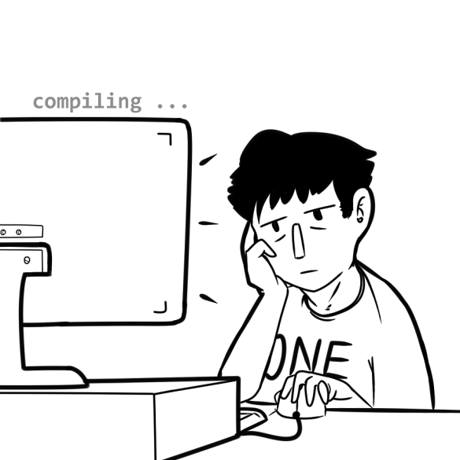
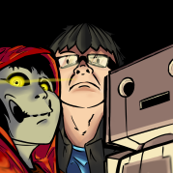
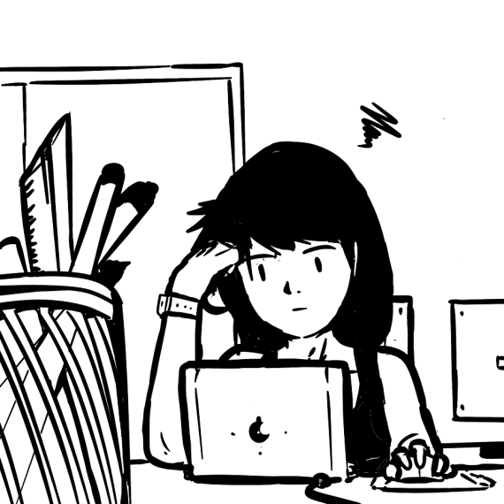
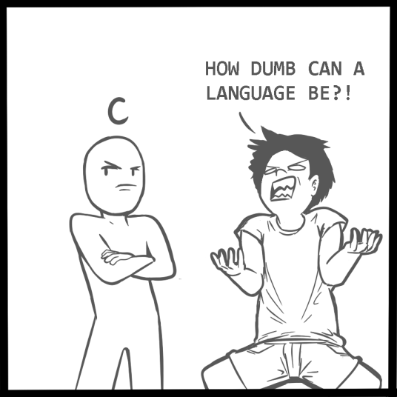
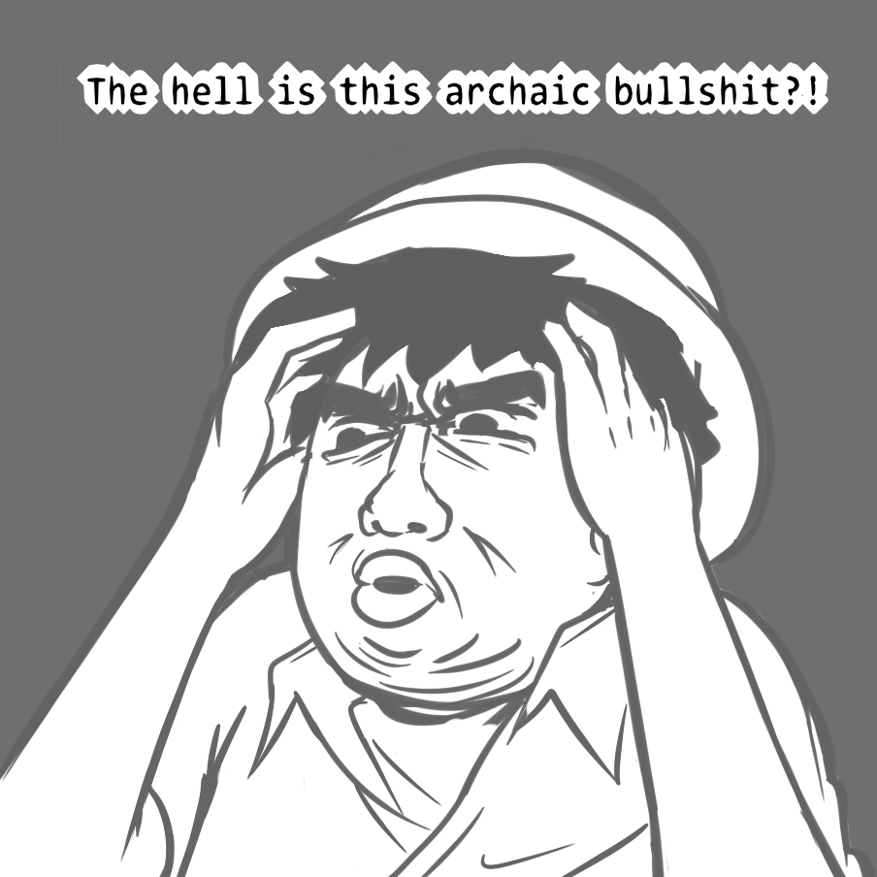
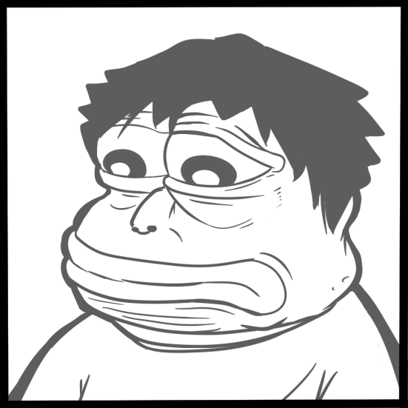
Encouragements
Check out Grumpy Codes:
Tapastic -
https://tapas.io/series/Grumpy-Codes
Instagram –
@cardboardvoice
Email –
cardboardmails@gmail.com

Slide 65
Thank you!

